Slide 1




[CHAPTER]
[TOPIC]
AIAA Caltech Student Branch – 18/11/20
Preliminary Design Review – H.O.M.E.S.
Header 1
Header 2
Header 3
Body
Note

Slide 2
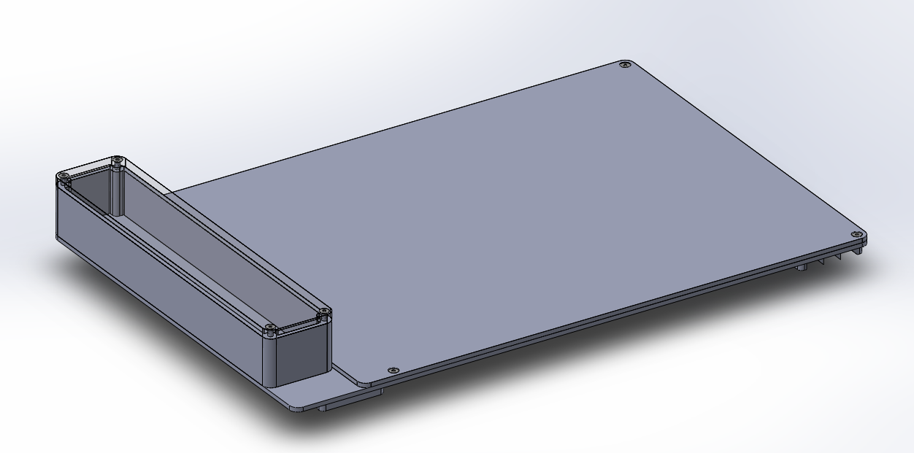
DESIGN OVERVIEW
MECHANICAL
AIAA Caltech Student Branch – 18/11/20
Preliminary Design Review – E.A.S.E
Objectives:
Strong enough to sustain weight
Easy to transport and use
Large enough size to comfortably use
Optimized for weight and volume
Electronics are secured and protected
Cost-effective solution
Protected from the harsh lunar environment
Use for 15-30 years.

Slide 3
DESIGN OVERVIEW
MECHANICAL
AIAA Caltech Student Branch – 18/11/20
Preliminary Design Review – H.O.M.E.S.
Metric | Weight | Single Panel | Single Fold Accordion
Use with EDS | 10 | 9 | 5
Robustness | 30 | 25 | 20
Weight and Volume | 20 | 20 | 12
Storage, transportation, deployment | 20 | 20 | 12
Life Cycle | 20 | 20 | 16
Total | 100 | 94 | 65

Slide 4
DESIGN OVERVIEW
MECHANICAL
AIAA Caltech Student Branch – 18/11/20
Preliminary Design Review – E.A.S.E

Slide 5
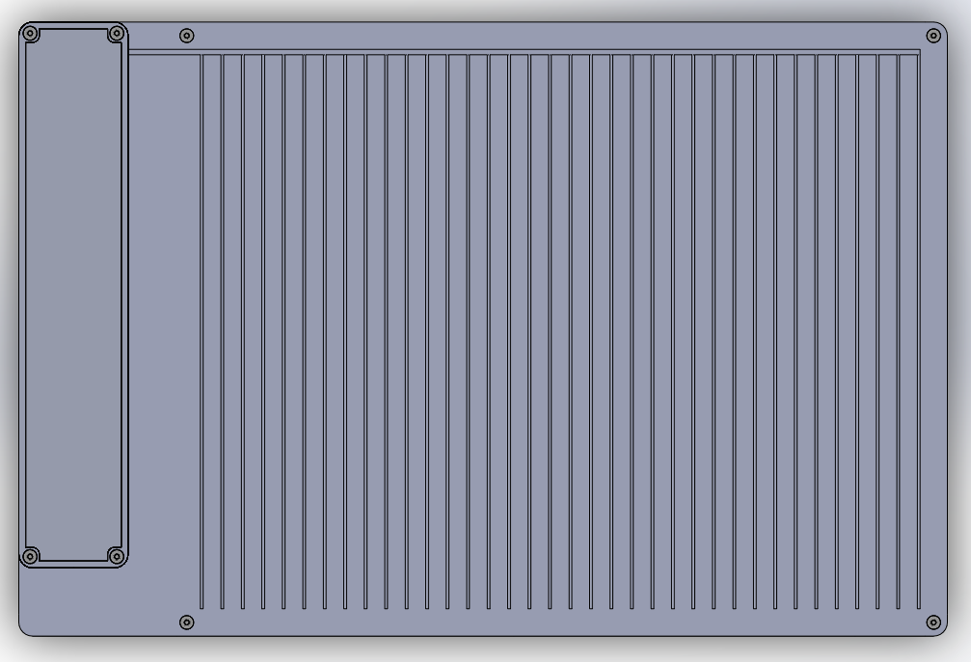
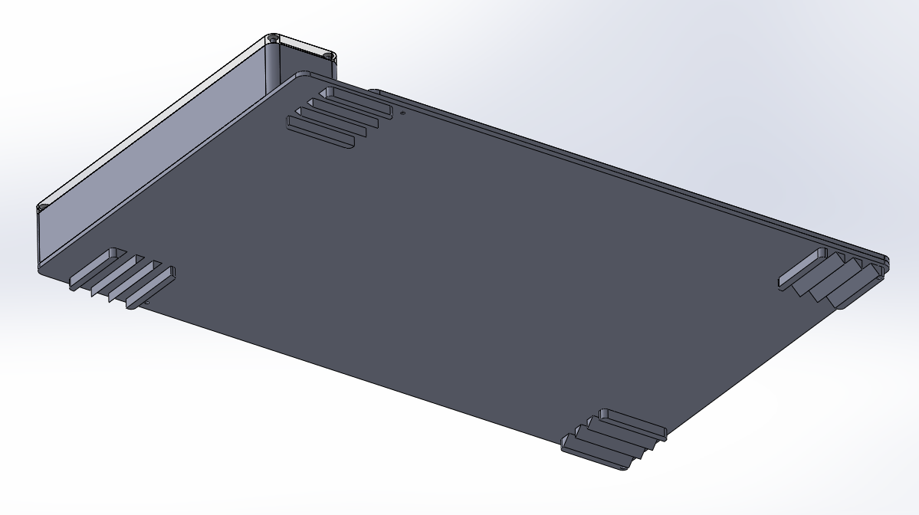
DESIGN OVERVIEW
MECHANICAL
AIAA Caltech Student Branch – 18/11/20
Preliminary Design Review – H.O.M.E.S.
Spikes for security
EDS System

Slide 6
PANEL COMPOSITION
MECHANICAL
AIAA Caltech Student Branch – 18/11/20
Preliminary Design Review – E.A.S.E
Lotus Coating
Alumina Ceramic Sheet
0.3175 cm
Kapton film
0.005 cm
Electrodes
0.65 cm
Kapton film
0.005 cm
Alumina Ceramic Sheet
0.3175 cm
Beta Cloth
0.00762 cm
0.77 cm
0.65 cm
iPhone X
EDS Panel
Mass estimate: 1.4 kg

Slide 7
MECHANICAL
MATERIAL SELECTION
AIAA Caltech Student Branch – 11/18/20
Preliminary Design Review – E.A.S.E.
 | Alumina Ceramic | Bolt | Beta-cloth | Kapton
Density | 3.9 (g/cm³) | 8.0 (g/cm³) | 2.71 (10⁻³ g/cm²) | 1.41 (g/cm³)
Tensile Strength | 260 (MPa) | 482 (MPa) | 3,450 (MPa) | 230 (MPa)
Flexural Strength | 379 (MPa) | 290 (MPa) | 13.4 (MPa) | 120 (MPa)
Compressive Strength | 2,600 (MPa) | 170 (MPa) | 758 (MPa) | 172 (MPa)
Coefficient of Thermal Expansion | 8.6 (10⁻⁶/ºC) | 10.3 (10⁻⁶/ºC) | 9.3 (10⁻⁵/ºC) | 8.1 (10⁻⁵/ºC)
Dielectric Constant | 9.1 (at 1 MHz) | - | - | 5.42 (at MHz)
Dielectric Strength | 16.7 (kV/mm) | - | - | 217 (kV/mm)
Temperature Range | -273.15 – 1,750 (ºC) | -252 – 871 (ºC) | -73 – 260 (ºC) | -267 – 398 (ºC)
Note: we will also put LOTUS coating on the top layer of the alumina sheet and use Cicoil wires

Slide 8
MECHANICAL
MATERIAL SELECTION
AIAA Caltech Student Branch – 11/18/20
Preliminary Design Review – E.A.S.E.
 | Alumina Ceramic | Bolt | Beta-cloth | Kapton
Density | 3.9 (g/cm³) | 8.0 (g/cm³) | 2.71 (10⁻³ g/cm²) | 1.41 (g/cm³)
Tensile Strength | 260 (MPa) | 482 (MPa) | 3,450 (MPa) | 230 (MPa)
Flexural Strength | 379 (MPa) | 290 (MPa) | 13.4 (MPa) | 120 (MPa)
Compressive Strength | 2,600 (MPa) | 170 (MPa) | 758 (MPa) | 172 (MPa)
Coefficient of Thermal Expansion | 8.6 (10⁻⁶/ºC) | 10.3 (10⁻⁶/ºC) | 9.3 (10⁻⁵/ºC) | 8.1 (10⁻⁵/ºC)
Dielectric Constant | 9.1 (at 1 MHz) | - | - | 5.42 (at MHz)
Dielectric Strength | 16.7 (kV/mm) | - | - | 217 (kV/mm)
Temperature Range | -273.15 – 1,750 (ºC) | -252 – 871 (ºC) | -73 – 260 (ºC) | -267 – 398 (ºC)
Note: we will also put LOTUS coating on the top layer of the alumina sheet and use Cicoil wires

Slide 9
MECHANICAL
MATERIAL SELECTION
AIAA Caltech Student Branch – 11/18/20
Preliminary Design Review – E.A.S.E.
 | Alumina Ceramic | Bolt | Beta-cloth | Kapton
Density | 3.9 (g/cm³) | 8.0 (g/cm³) | 2.71 (10⁻³ g/cm²) | 1.41 (g/cm³)
Tensile Strength | 260 (MPa) | 482 (MPa) | 3,450 (MPa) | 230 (MPa)
Flexural Strength | 379 (MPa) | 290 (MPa) | 13.4 (MPa) | 120 (MPa)
Compressive Strength | 2,600 (MPa) | 170 (MPa) | 758 (MPa) | 172 (MPa)
Coefficient of Thermal Expansion | 8.6 (10⁻⁶/ºC) | 10.3 (10⁻⁶/ºC) | 9.3 (10⁻⁵/ºC) | 8.1 (10⁻⁵/ºC)
Dielectric Constant | 9.1 (at 1 MHz) | - | - | 5.42 (at MHz)
Dielectric Strength | 16.7 (kV/mm) | - | - | 217 (kV/mm)
Temperature Range | -273.15 – 1,750 (ºC) | -252 – 871 (ºC) | -73 – 260 (ºC) | -267 – 398 (ºC)
Note: we will also put LOTUS coating on the top layer of the alumina sheet and use Cicoil wires

Slide 10
MECHANICAL
MATERIAL SELECTION
AIAA Caltech Student Branch – 11/18/20
Preliminary Design Review – E.A.S.E.
 | Alumina Ceramic | Bolt | Beta-cloth | Kapton
Density | 3.9 (g/cm³) | 8.0 (g/cm³) | 2.71 (10⁻³ g/cm²) | 1.41 (g/cm³)
Tensile Strength | 260 (MPa) | 482 (MPa) | 3,450 (MPa) | 230 (MPa)
Flexural Strength | 379 (MPa) | 290 (MPa) | 13.4 (MPa) | 120 (MPa)
Compressive Strength | 2,600 (MPa) | 170 (MPa) | 758 (MPa) | 172 (MPa)
Coefficient of Thermal Expansion | 8.6 (10⁻⁶/ºC) | 10.3 (10⁻⁶/ºC) | 9.3 (10⁻⁵/ºC) | 8.1 (10⁻⁵/ºC)
Dielectric Constant | 9.1 (at 1 MHz) | - | - | 5.42 (at MHz)
Dielectric Strength | 16.7 (kV/mm) | - | - | 217 (kV/mm)
Temperature Range | -273.15 – 1,750 (ºC) | -252 – 871 (ºC) | -73 – 260 (ºC) | -267 – 398 (ºC)
Note: we will also put LOTUS coating on the top layer of the alumina sheet and use Cicoil wires

Slide 11
MANUFACTURING
MECHANICAL
AIAA Caltech Student Branch – 18/11/20
Preliminary Design Review – H.O.M.E.S.
Top Plate:
3-axis CNC milling
Bottom Plate:
3-axis CNC milling
Electronics Box:
Tungsten inert gas welding
3-axis CNC milling
Design considerations: 0.5 mm tolerance, large external and internal fillets
Will outsource machining.

